Slide 1
CONNECT Telephony for Microsoft

Slide 2
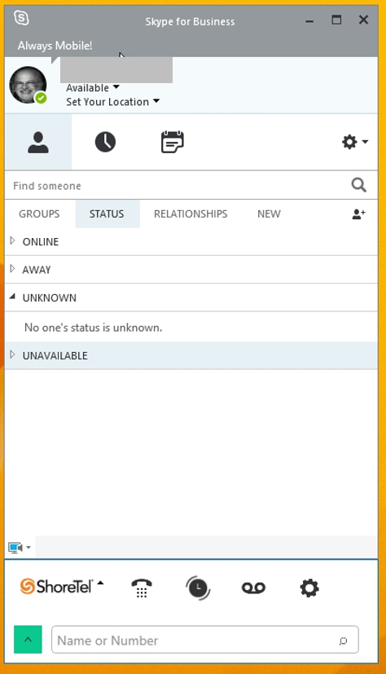
OVERVIEW: CONNECT TELEPHONY FOR MICROSOFT
Single Interface
  Manages business communications
  Primary collaboration client in LYNC
  Compatible with LYNC on line and premise
Features included:
  Calling
  Call Transfer
  Dual-tone Multi-frequency (DTMF)
  Conferencing
  Call History
  Voicemail
  Softphone
Notes:
The ShoreTel Connect client Lync plug-in for Microsoft Lync presents a single interface to manage business communications using Microsoft Lync as the primary collaboration client. This Plug-in integrates the ShoreTel telephony features with Microsoft Lync. The ShoreTel Connect client Lync plug-in works on both Lync premise and Office 365 (Lync Online) clients.
The ShoreTel Connect client integration with Microsoft Lync offers the following features:
Calling
Call Transfer
Dual-tone Multi-Frequency
Conferencing
Call History
Voicemail
Softphone

Slide 3

PRODUCT PRE-REQUISITES
To set background, right click on slide and choose ‘Format Background’.
Choose ‘Picture of Texture’ then Insert from ‘File’.

Slide 4


COMPATIBLE OPERATING SYSTEMS
Compatible Client Operating Systems
  Windows 7, Windows 8, Windows 10
Incompatible Operating Systems
  LYNC for MAC
Notes:
The compatible operating systems to work with the Connect Telephony for Microsoft include Windows 7, Windows 8, and Windows 10. At this time, LYNC for MAC is not compatible with our plug-in elements

Slide 5

MICROSOFT LYNC COMPATIBILITY
Compatible Clients
  Skype for Business
  LYNC 2013
Compatible Servers
  LYNC 2013
  Office 365
  LYNC Online
Compatible ShoreTel Release
  ShoreTel Connect
Notes:
When considering the compatibility for the Microsoft LYNC product there are two considerations. First we must consider the Compatible Client for the LYNC product. Currently SKYPE for Business and the LYNC 2013 client will integrate with the Connect Telephony for Microsoft.
Secondly we must consider the compatibility with the LYNC servers. LYNC Online, Office 365 and LYNC 2013.

Slide 6

PRODUCT FUNCTIONALITY
To set background, right click on slide and choose ‘Format Background’.
Choose ‘Picture of Texture’ then Insert from ‘File’.

Slide 7
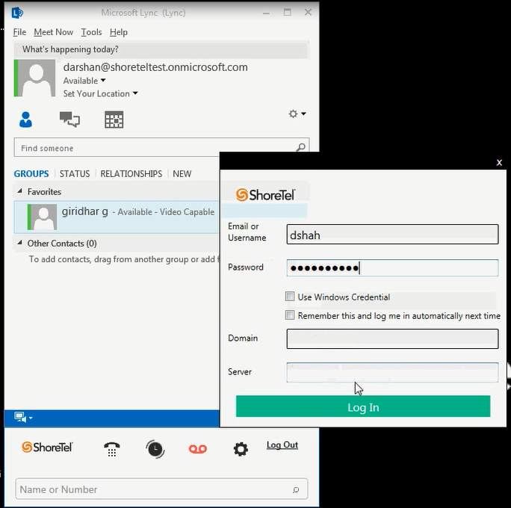
Signing into the Client
Required Credentials:
  Settings
  Enter the User Credentials
  Show Advanced to ender the FQDN in Server Field
  Log in
Notes:
Signing into Connect Telephony for Microsoft plug-in
Before you start using the Connect Telephony for Microsoft plug-in, you must sign in using your ShoreTel Connect client credentials.
To log out, click Log Out at the right side of the Connect Telephony for Microsoft plug-in pane.
Signing in with ShoreTel User Credentials
1. On the Connect Telephony for Microsoft plug-in pane, click LOG IN icon. The ShoreTel Connect client login screen is displayed.
2. Enter your user credentials.
3. Click +Show Advanced, enter the fully qualified domain name (FQDN) in the Server field.
4. Click Log In.

Slide 8
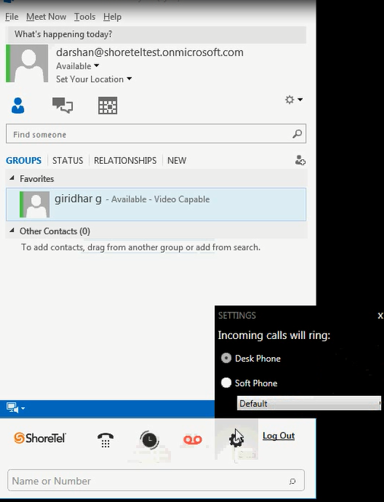
OPERATIONS
  Softphone
    Requires permission on User Profile
  Deskphone control
Notes:
Deskphone
If you select the deskphone, you can manage all calls and voicemails using ShoreTel Connect client Lync plug-in as you manage calls with the deskphone.User Guide ShoreTel Connect Client Lync Plug-in
Softphone
If you assign your extension to the softphone, all calls are routed to ShoreTel Connect client Lync plug-in. The deskphone functionality is suppressed till you assign your deskphone again in the settings screen. Softphone permissions will require

Slide 9
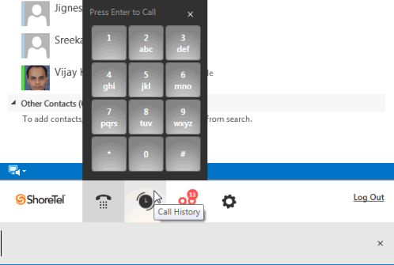
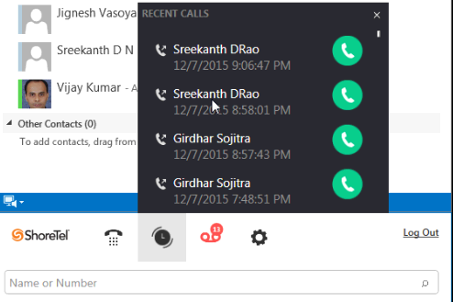
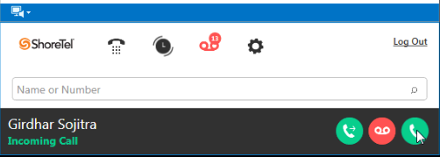
CALL SETUP
  Dial Pad
  Call History
  Incoming Calls
Notes:
Placing a Call from the Dialpad
The dialpad allows you to place calls to your internal and external contacts using the ShoreTel Connect client Lync plug-in.
Placing a Call from History
History will show the calls recently placed or received.

Slide 10
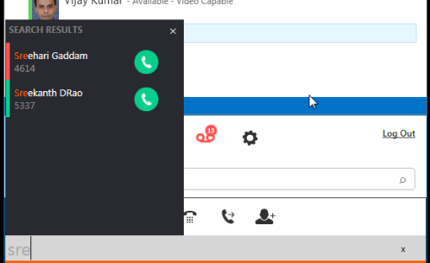
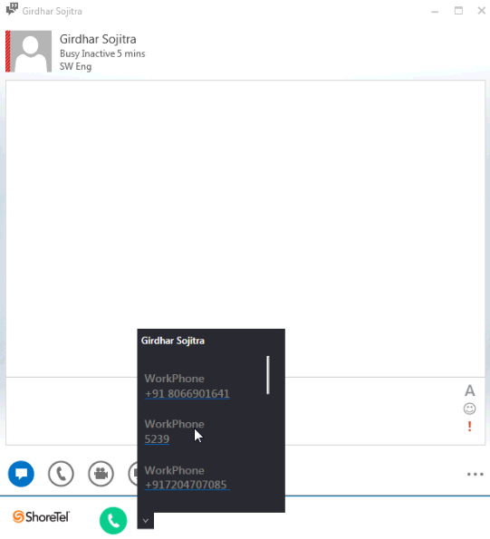
CALL SETUP
  Call from the Search Bar
  Call from the Conversation Window
Notes:
Placing a Call from the Search Bar
The rectangular area below the dialpad icon is the search bar. You can use this area to enter the first name or last name, extension, or phone number.
Type the contact details in the search bar, and press Enter.
Click the Dialpad icon. The dialpad is displayed.
Dial the extension or the mobile number, and press Enter. The call is placed from the dialpad.
The call is placed from the search bar.
Type the contact details in the search bar, and press Enter.
Placing a Call from the Conversation Window
Double-click the contact in the Lync contact list. Contact details screen is displayed.
2. Click the drop-down list next to the green call icon in the Connect Telephony for Microsoft pane. The contact numbers associated with the selected contact are displayed.
3. Click the number to place the call.

Slide 11
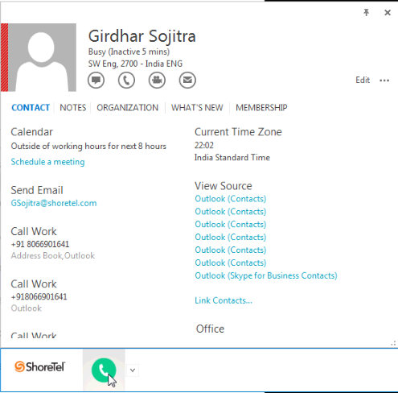
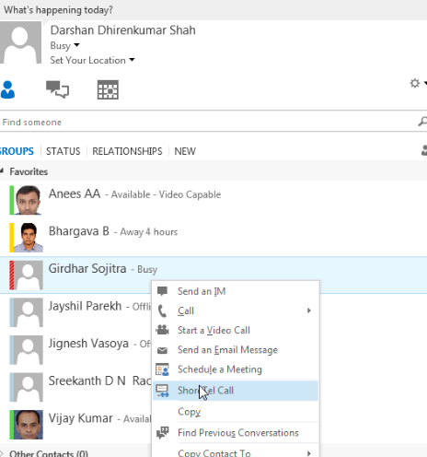
CALL SETUP
  Call from the Contact Card
  Call from Contact Menu
Notes:
Placing a Call from the Contact Card
Right-click the contact in the Lync window. Contact menu is displayed.
Click See Contact Card in the contact menu.
Click the drop-down list next to the green call icon in the Connect Telephony for Microsoft pane.
Click the number to place the call.
Placing a Call from the Contact Menu
Right-click the contact in the Lync window. Contact menu is displayed.
Click ShoreTel Call option in the contact menu.

Slide 12
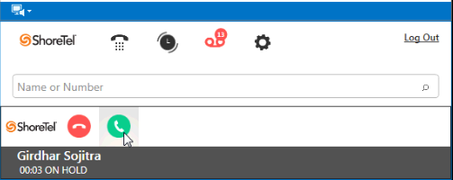
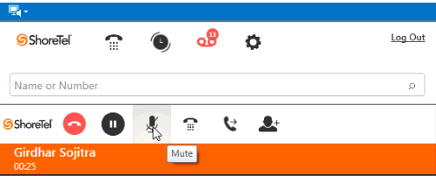
IN-CALL CONTROLS
Mute
DTMF Dialpad in Call
Hold and Resume
Notes:
When you are on a call, you can place the caller on hold and resume as required. The hold and resume options are also available on the contact details screen.
Click the pause icon to place the call on hold.
Click the green call icon to resume the call.
Using the DTMF Dialpad in Conference Calls
Connect to the third-party conference bridge.
2. Click DTMF icon on the ShoreTel Connect client Lync plug-in pane. The DTMF dialpad is displayed.
Type the conference pin, and press Enter.
Using the DTMF Dialpad in Interactive Voice Calls
Connect to the interactive voice call.
2. Click DTMF icon on the ShoreTel Connect client Lync plug-in pane.
Type the option numbers as required.
Muting a Call
To mute or unmute your audio during the call, click the mute icon on the ShoreTel Connect client Lync plug-in pane.

Slide 13
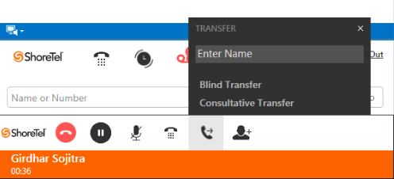
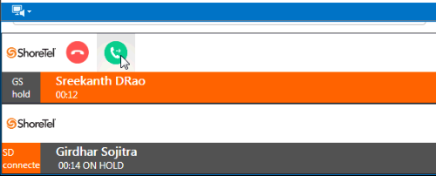
IN-CALL CONTROLS
Transfer
  Blind
  Consult
Notes:
Transferring a Call
You can do a blind transfer or consultative transfer using ShoreTel Connect client Lync plug-in.
To transfer a call:
View the active call in the notification area.
To transfer an active call, click the green call transfer icon. The Transfer screen is displayed with the call transfer options.
In the search field, type the contact name or the phone number to transfer the call.
Click Blind Transfer or the Consultative Transfer as required. When you click on consultative transfer, a new notification is seen in the notification area with a red end call icon and a green call transfer icon. You can consult the contact receiving the transfer and transfer or end the call as required.
Adding a Contact to an On-going Call
You can add participants to an on-going call using ShoreTel Connect client Lync plug-in.
To add a contact:
Click the drop-down list to view the list of participants on the call, Lync status, participants on mute, and the speaker.
Click the Add Contact icon. The dialpad is displayed for adding a contact.
ype the contact name, number, or the extension, and press Enter. The contact is added to the call.

